Slide 1
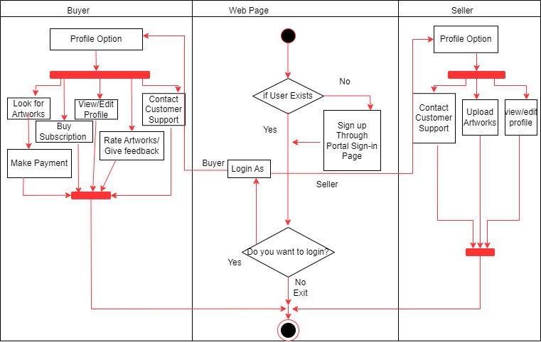
Revolution Art
Activity Diagram

